Slide 1
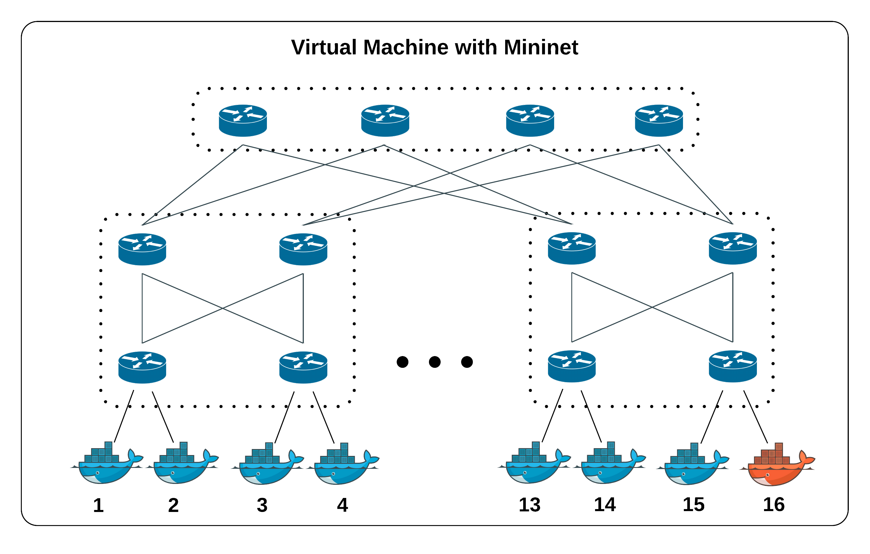
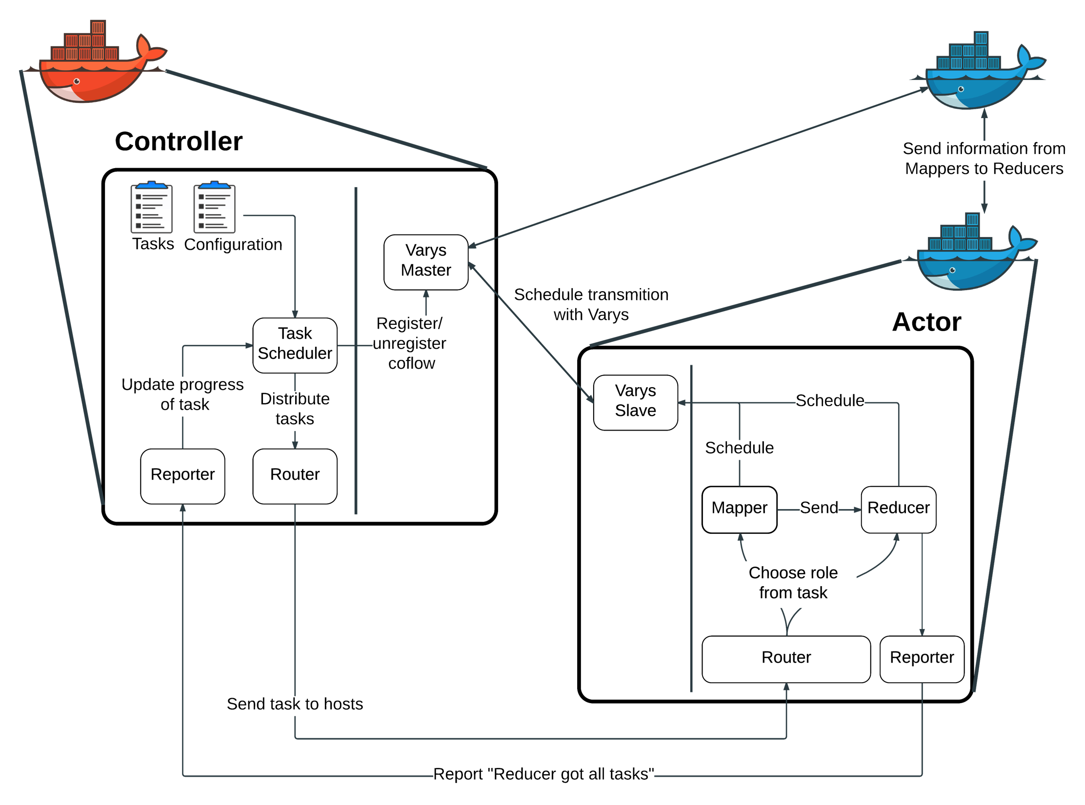
CSE 222A Fall 2015 Group 6 – Coflow Scheduling
Amit Borase, Stas Mushits, Ruby Pai, Sreejith Unnikrishnan, Ritvik Jaiswal
Coflow Abstraction [1], [2]
Simulation Setup
Experiment
Motivation: Data parallel application-aware cluster network scheduling.
Definition: A collection of flows that have a common goal.
Examples: Shuffle in Map-Reduce, bulk synchronous processing
Coflow completion time (CCT) is what matters to application.
Motivation: Current coflow schedulers require applications to identify coflows to the scheduler via an API. Future use of coflow schedulers would be supported by automatic coflow identication, easing programmer burden
Automatic coflow identification techniques will be less than 100% accurate, so it is useful to evaluate the performance of state-of-the-art coflow schedulers as a function of knowledge of flows in a coflow. (reword)
Describe experiment details here.
Coflow Schedulers [1], [2]
Inter-coflow scheduling is NP-hard
Recent research results use heuristics
Varys (2014):
Shortest effective bottleneck first
Key idea: exploit differences between flow lengths in a coflow – do not allocate more bandwidth to a flow than necessary for flow to meet minimum possible CCT
Ave. 3.16x faster coflow completions
Aalo (2015):
No prior knowledge of coflow characteristics
Key idea: generalize least attained service to coflows
Ave. 1.93x faster coflow completions
Simulation Controller Software
Results
Graph of average CCT for increasing number of unlabeled flows in coflow
Summarize take-away
References
[1] Chowdhury, Mosharaf and Ion Stoica, Efficient Coflow Scheduling Without Prior Knowledge, SIGCOMM 2015
[2] Chowdhury, Mosharaf, Yuan Zhong and Ion Stoica, Efficient Coflow Scheduling with Varys, SIGCOMM 2014
Chowdhury, Mosharaf and Ion Stoica, Coflow: A Networking Abstraction for Cluster Applications, Hotnets 2012

